Slide 1
System Architecture Part 1
Lets scale that system!!

Slide 2
What We will be learning ?
1. Building a Client-Server Application
2. SwiftUI framework and MVVM design
3. Django Server and MVT design
4. Postgres(SQL dB)
5. Demo
6. Scalability and Benchmarking

Slide 3
1. Client-Server App
Client Side: iOS Client that uses SwiftUI framework and MVVM
Server Side: Django server using MVT in Python + Postgres Db
iOS Client
Server
(Django)
Postgres

Slide 4
2. MVVM Design Paradigm
Works in concert with the concept of “reactive” user-interfaces.
Must be adhered to for SwiftUI to work
MVVM != MVC(Model View Controller used by UIKit)

Slide 5
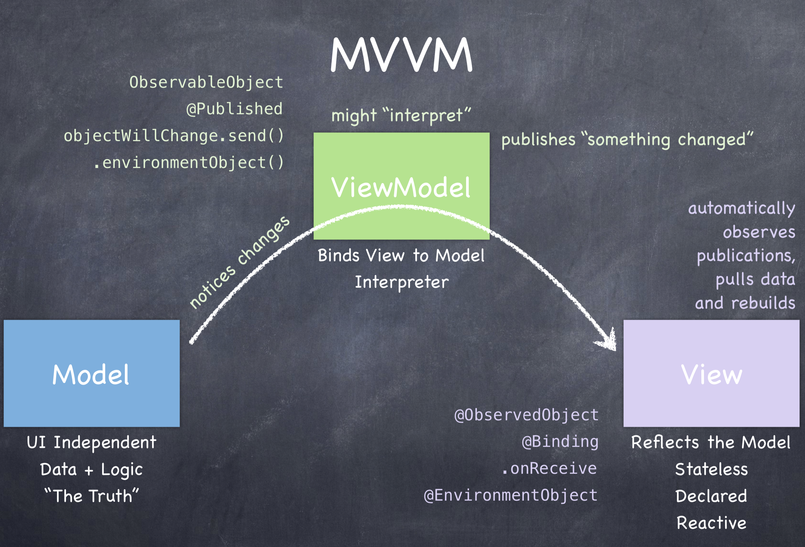

Slide 6
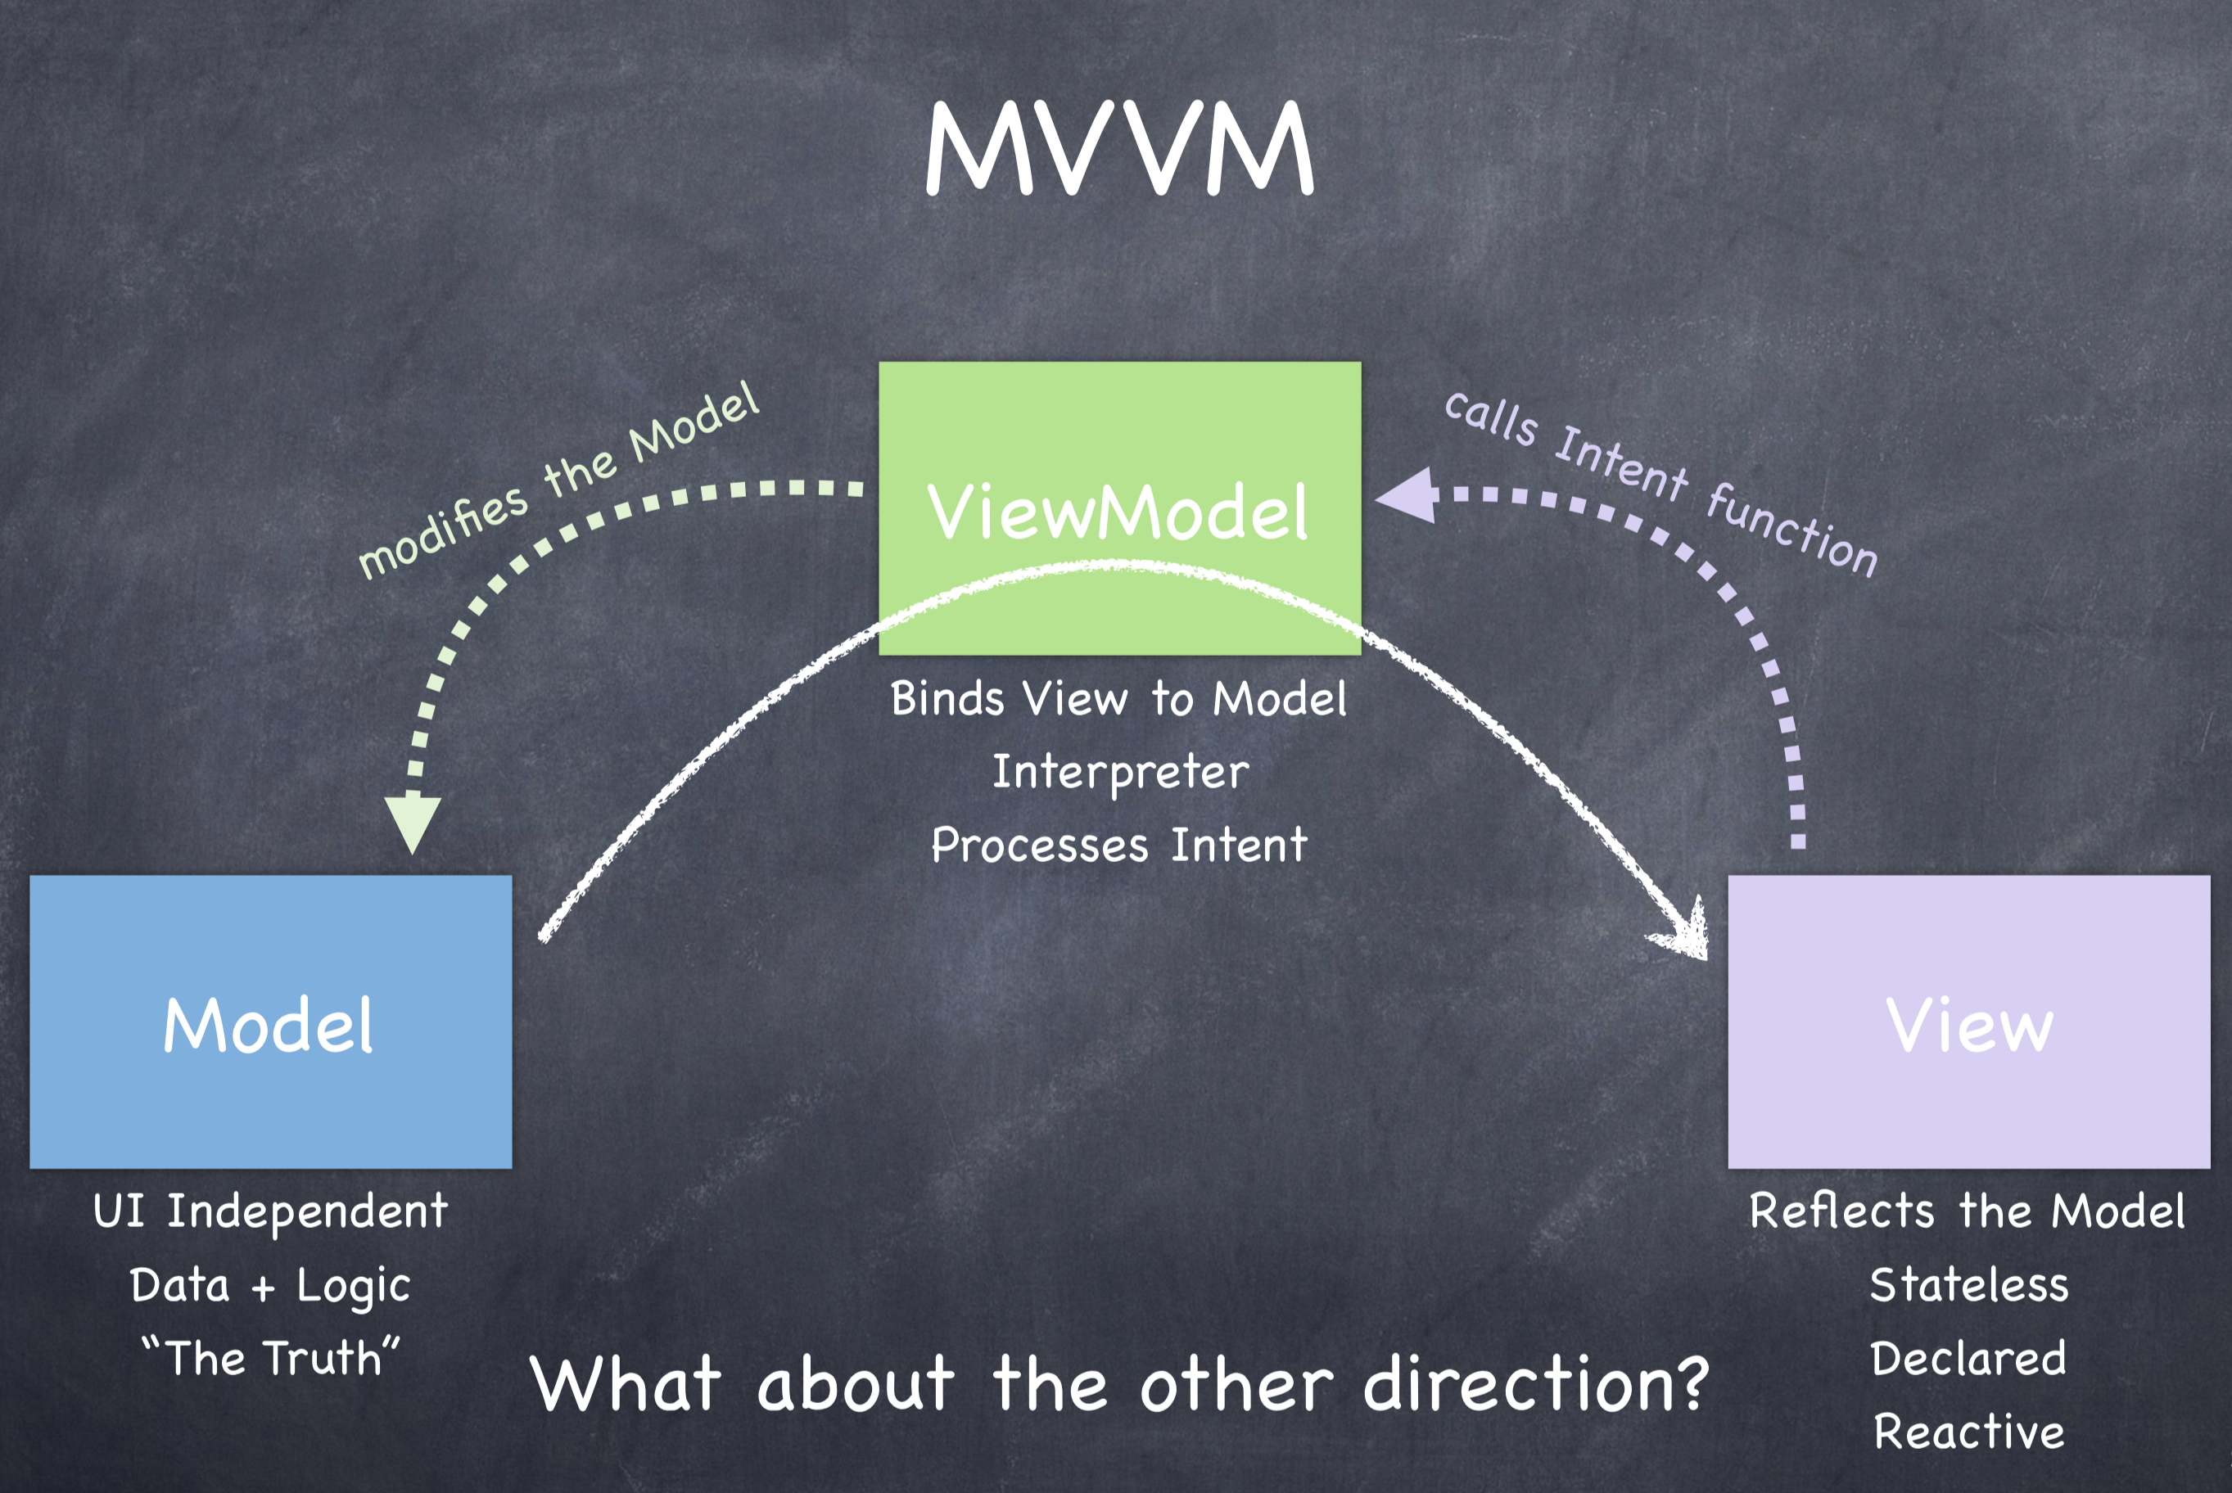

Slide 7
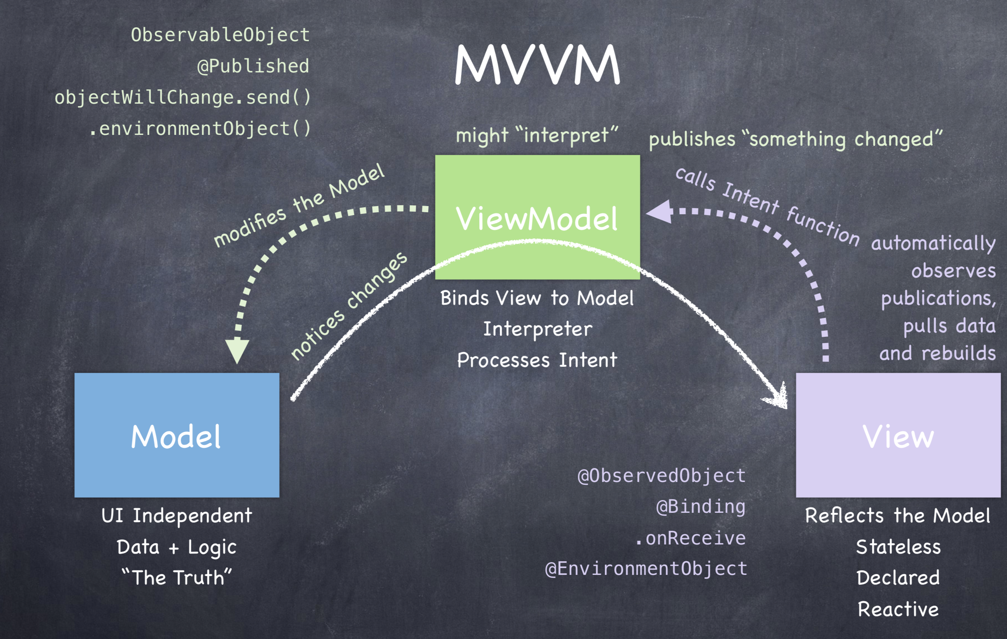
MVVM Design

Slide 8
3. Model View Template
urls.py: Determines what urls(routes) a client can go to
Views.py: Decides what should happen when the client makes a url request
Models.py: Define the types of data we store inside the database
Template: Template engine to manage Html files for a web App
Urls.py
Views.py
Models.py
Template
(Htmls)

Slide 9
4. PostgreSQL
Object Relational Database system
Settings.py: Choose the dB of your choice
DATABASES = {
'default': {
'ENGINE': 'django.db.backends.postgresql_psycopg2',
'NAME': 'postgres',
'USER': 'amrbhardwaj',
'HOST': '127.0.0.1',
'PORT': '5432',
}
}

Slide 10
Let’s see all this in action !! ☺

Slide 11
6. Scalability
What happens after we have written our application ?
What happens if the application gets viral and billions of people start to access the application data at the same time globally?
What sort of considerations we need to take into account ?

Slide 12
6. Scalability
iOS
iOS
Server
I am sick ☹
dB
iOS
iOS
iOS

Slide 13
6. Benchmarking
•The server processes the client requests and delivers the response back to the user
•Server can do only a finite number of things
•How do we measure the number of requests/second a server can handle ?
•How do we measure latency response time(ms) for each new connection or request ?
•How do we measure throughput in bytes/second ?

Slide 14
6. Benchmarking Tools/Reports
1. Apache Bench
2. Apache Jmeter
3. Django-performance-testing framework, etc
Lets Try:
$ ab -n 100 -c 10 http://127.0.0.1:8000/
-n = Number of requests = 100
-c = number of concurrent requests = 10

Slide 15
Eventual Consistency
CDN
Replication
Network Topology
Load-Balancing
Bandwidth
Single Point of Failure
Auto-Scaling
Sharding
Cache Invalidation
Partition Tolerance
Message Queue
Caching Policy
DNS
Throughput
NoSQL-BASE
Master-Slave
SQL Indexing
Server Heartbeat
REST
Federation
Microservice
Sticky Session
2 Phase Commit
RPC
Latency
CAP Theorem
Normailzation
Consistent Hashing
Reverse Proxy
Server Benchmarking
Denial of Service Attack

Slide 16
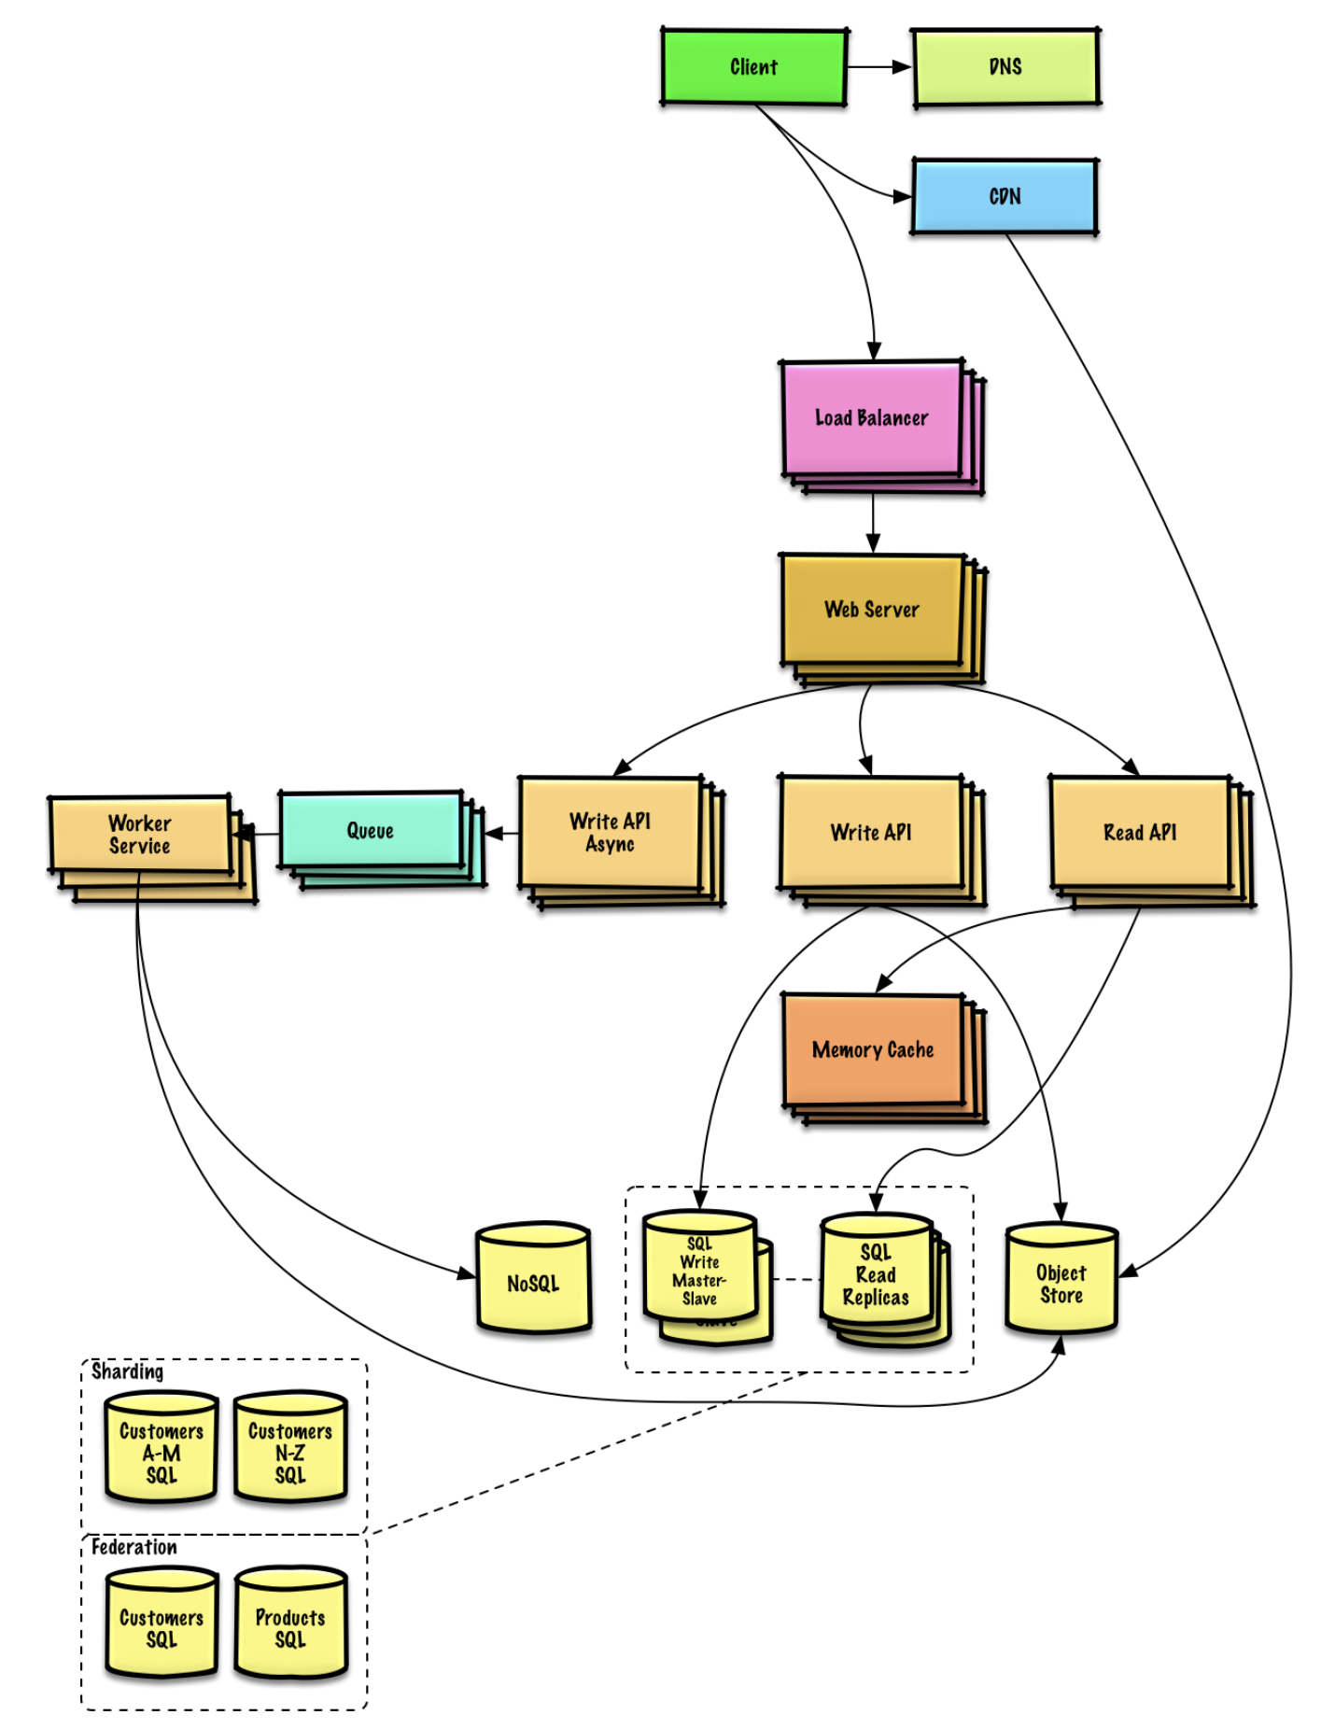

Slide 17
Stay Tuned for Next Session Questions ?

